Slide 1
Primary Technical Documentation
Joshua Bartle

Slide 2
Natural Language Processing: Text Error Detection and Auto-completion
Building Blocks
Finite State Machines to Define a language and detect Errors
“Finite-state automata (both acceptors and transducers) play increasingly important role in natural language processing. There main advantages are their small size as compared with the data they hold . . . and the very fast lookup of string in an automaton -- proportional to the length of the string. . . In natural language processing, they are used for tasks like spelling correction . . .” (Dakiuk, Jan)
“For error-tolerant recognition, one needs to find all paths from the start node to one of the final nodes, so that when the labels on the links along a path are concatenated, the resulting string is within a given edit distance threshold t, . . . “(Oflazer, Kemal 75)
Summary of quotes/Algorithms
The best way to define a language is to implement it in terms of states, this reduces size and increases speed of processing strings in a language
Finite State machines can also be used to measure the edit distance between incorrectly spelled words to a correctly spelled word in our dictionary. This can be done by measuring how many operations (insertions, deletions, transpositions) are required to reach an accepting state.

Slide 3
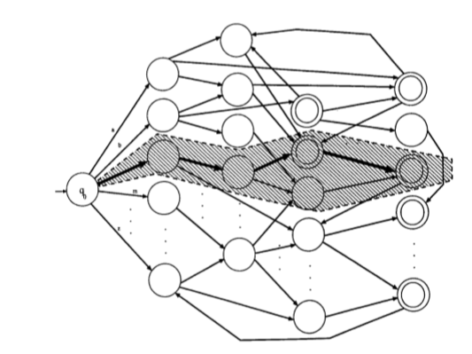
State Machine Diagram
Visual representation of a Finite State Machine
When a dead state is reached (a state that has no way to reach an accepted state), the path that requires the least amount of changed to reach an accepted state is chosen.
(Oflazer, Kemal 75)

Slide 4
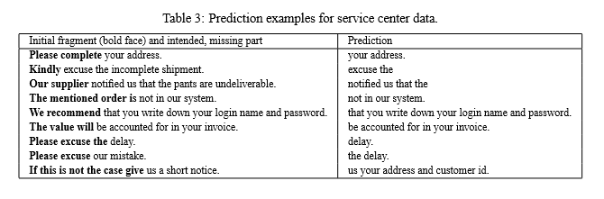
Multi-Word Models for Error Detection and Auto-Completion
“First, we use it to find pairs of words that function together as a single lexical entity. Then, by examining the probability that two words will appear within a reasonable distance of one another, we use it to find classes that have some loose semantic coherence.” (Brown, Peter F., et al 467)
NOTE: Using N-Gram models for auto-correct and auto-complete work similarly, we can use probabilities of word combinations in training text to determine spelling correction actions or auto-complete actions.
(Bickel, Steffen et al. 198)

Slide 5
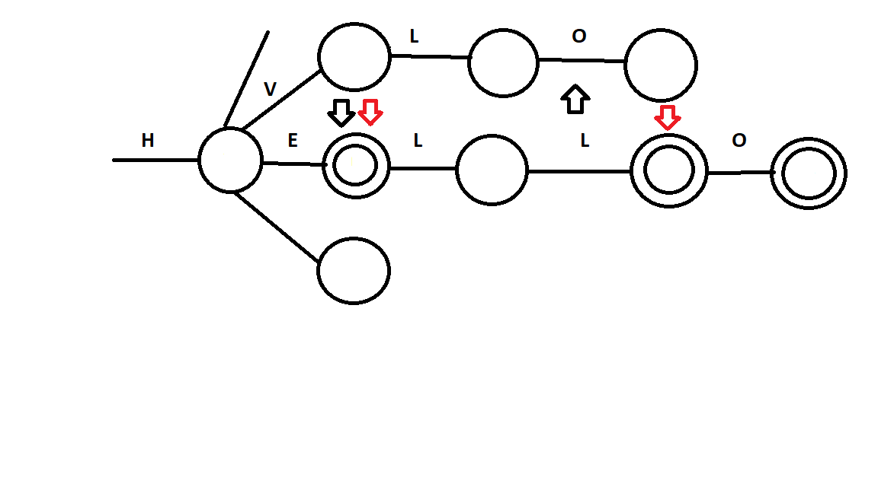
Using State Machines AND N-Gram Algorithms Together: How I intend to combine them
Given this example created in MS PAINT you can see where using a multi-word analysis with FSM would be useful
Given user input: HVLO, we can generate HELLO with one insertion of L and one transposition of V to E. We can also generate HELL by transposing V and E and O to L. Both of these changes require to operations, which makes it difficult to choose which word the user intended to input
By analyzing various texts from user history or other documents, one can train our N-Gram modeled algorithm on data to calculated the probability that the user would use HELL vs HELLO.

Slide 6
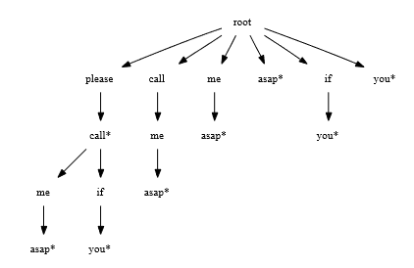
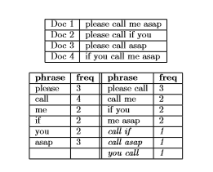
Creating search trees for phrases
“Suﬃx trees are widely used, and are ideal data structures to determine completions of given strings of characters. Since our concern is to ﬁnd multi-word phrases, we propose to deﬁne a suﬃx tree data structure over an alphabet of words.” (Nandi, Arnab, and H. V. Jagadish. 222)
“The construction of suﬃx trees typically uses a sliding window approach.” (Nandi, Arnab, and H. V. Jagadish. 223)
Summary of Diagrams
Creating a suffix tree for phrases allows one to efficiently store common phrases and word combinations in the form of a search tree.
This can be created by taking a phrase or words and expanding all other combinations of phrases as nodes in a search tree.
Frequencies of words and combinations of words can be stored with their probabilities.
The * after each word denotes the end of a phrase or word group. This can be used to determine which phrases have probabilities associated with them.
(Nandi, Arnab, and H. V. Jagadish. 222)
(Nandi, Arnab, and H. V. Jagadish. 224)

Slide 7
Other Enhancements
Identifying Casing Errors
“For example, consider the phrase with improper casing, “shipping TIME frame”. Appearing as an independent word, “TIME” has an equally likely chance of being a word (with improper casing) or an acronym for “Timed Interactive Multimedia Extensions”” (Wong, Wilson et al. 85)
“When the neighboring words “shipping” and “frame” are taken into considerations, then the probability of “TIME” being an acronym becomes signiﬁcantly less.” (Wong, Wilson et al. 85)
The previous quotes discuss detection casing errors. This can be something very useful in error detection. This also using N-gram or multiword probabilities to assess if a word such as “TIME” has incorrect casing or may be an acronym

Slide 8
Final Objective
Statement: To compare the effectiveness of the n-gram techniques and compare the accuracy using different values of n by using the methods described in “Predicting Sentences Using N-Gram Language Models.” by Bickel, Steffen et al., for text error correction.(1.5 person-weeks over 1 semester)

Slide 9
What will be measured
Accuracy of using n-gram probabilities from training text
Get Accuracy when considering 1, 2, … , n words in a sequence (Words will be corrected based on the probability of word sequences)
Determine which value of n provides the greatest accuracy in corrections

Slide 10
Experiment Design
Description: A finite state machine is created from a dictionary containing all words in the English language. The finite state machine is then used along with 2/3 of a set of random test documents to correct random errors in the document using edit distance and the n-gram model using different values of n for each test.
Each n-gram run will use 1/3 random documents for testing correction, but will also use the other 2/3 of those documents for training. Training involves calculating frequencies and probabilities that a sequence of n words will appear in text. These sequence probabilities will then be used in the 2/3 size set of test documents to determine corrections for incorrectly spelled words.
The n-gram model will be tested with values of 1-4 for n and there will be a total of 10 trials comparing edit distance by itself versus n-gram techniques as an enhancement with edit distance.

Slide 11
Current Progress
Finite State machine created and tested with JUnit
Edit Distance Algorithm created and tested with Junit
Begin implementation of the n-gram model.
Create a class that runs all parts together (FSM, edit distance, n-gram model) on text
Once everything is verified to be working, tests can be run
What’s next

Slide 12
Bibliography
Bickel, Steffen et al. “Predicting Sentences Using N-Gram Language Models.” Proceedings of the conference on Human Language Technology and Empirical Methods in Natural Language Processing - HLT ’05 October (2005): 193–200. Web.
Brown, Peter F., et al. “Class-Based N-Gram Models of Natural Language" Computational Linguistics 1950 (1992): Print.
Daciuk, Jan. “Finite State Tools for Natural Language Processing.” Proceedings of the COLING-2000 Workshop on Using Toolsets and Architectures To Build NLP Systems (2000). Print.
Nandi, Arnab, and H. V. Jagadish. “Effective Phrase Prediction.” Proceedings of the 33rd International Conference on Very Large Data Bases (2007): 219-230. Web.
Oflazer, Kemal. “Error-Tolerant Finite-State Recognition with Applications to Morphological Analysis and Spelling Correction.” Computational Linguistics 22.1 (1996): 73–89. Web.
Wong, Wilson et al. “Integrated Scoring for Spelling Error Correction, Abbreviation Expansion and Case Restoration in Dirty Text.” Conferences in Research and Practice in Information Technology Series 61 (2006): 83–89. Print.

